Slide 1

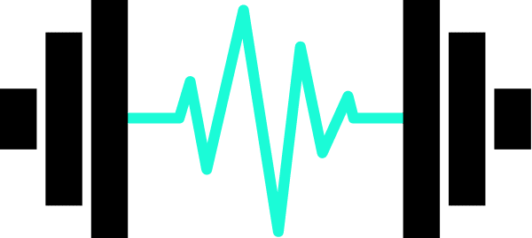
INSTITUTO SUPERIOR DE ENGENHARIA DE LISBOA Departamento de Engenharia Eletrónica e Telecomunicações e Computadores
Intelligent Sports Weights
TFM11 - Apresentação intermédia
Dissertação de Mestrado 2023/2024
Olga dos Santos Duarte, Nº 27675

Slide 2
Presentation Outline
Introduction & Motivation
03
Objectives
04
Related Works on Movement Recognition
05
Relevant Technologies on Movement Recognition
10
Low and No Code Platforms to train NN
11
Ultra Low Power Embedded System
12
Solution Outline
13
Preliminary Results
16
Work Plan
19
Conclusions
20

Slide 3
Introduction & Motivation
Build an embedded system in a microcontroller with a trained Neural Network, using TinyML.
Use of low code or no code platform.
Program a neural network on low power microcontroller.
01
02
03
Safe Physical Exercise
Embedded Systems
Real time feedback
Identify the correctness of fitness exercises to avoid injury.
Autonomous, low-power, small size
Sensors in gym equipment to provide feedback.
Notes:
Este microcontrolador tem uma plataforma estilo no code que permite treinar uma rede neuronal e fazer o deployment diretamente no micro. Para ter uma experiência rápida de treino de rede, como é adeuqação com o nosso problema. Exploração da plataforma.​
Após ganhar confiança com a rede.​
Depois vamos fazer a aquisição de dados, temos uma rede implementada - o esqueleto – que será implementada em software. Para permitir fazer otimizações que a plataforma no code não irá permitir.​
​Uma abordagem top-down.​
Ter a ferramenta da plataforma para agilizar a explicação do modelo da rede neuronal​
Depois "olear" isto desenvolvendo em software, começar por detectar movimentos numa rede já treinada - depois explorar nos movimentos aliados ao desporto.​
​
Não só vou recolher
Como vou Criar o data set
Vou treinar a rede
Implementar a rede no mcu
Optimizada
Usa o Arduino IDE - e implementa a rede neural em funções básicas
Extração de features:
Vamos usar tinyML para fazer o ensaio da rede neuronal e também fazer a exploração da extração de features, ou seja, o código da extração de features
entram dados e saiem features - vamos usar essa caixa preta para nos fazer esse código. Vou usar o edge impulse para explorar diferentes configurações
ponto de partida vai ser usar a extração de features do edge impulse, recolho o dataset, guardo no ficheiro, e a seguir uso o edge impulse para explorar diferentes confirgurações da rede neuronal
depois treinar a rede
implementar a rede
Edge impulse para guiar desenvolvimento

Slide 4
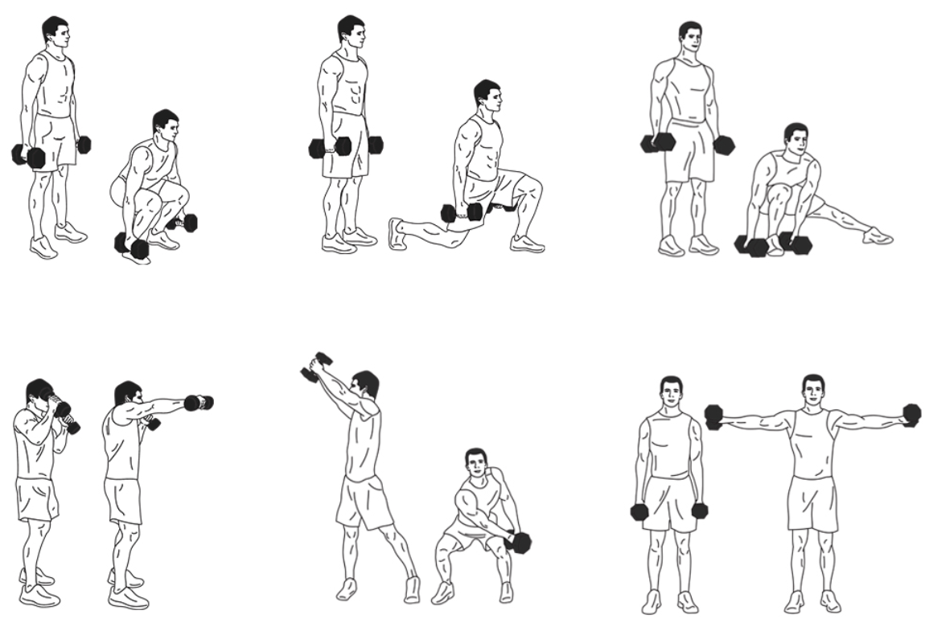
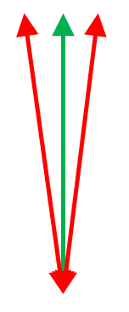
Objectives
01
Autonomy - Operate autonomously with a battery for more than 8h.
02
Compact Design – Compact and lightweight facilitating ease of use during exercise and to be attached to gym equipment.
03
Real-time Data Acquisition - Capability to collect motion data using accelerometer data in real-time and communicate to a host device using BLE.
04
Training NN - Train a NN model with a custom dataset for different exercise movements and with correct and incorrect labels.
05
Classification - validate the movement via a trained NN.
06
Feedback - provide real-time feedback to the user.

Slide 5
Related Works on Movement Recognition
Neural Networks for classification and movement recognition. Works were investigated in multiple areas such as:
01
Human Activity Recognition
S. Gupta, “A tinyml approach to human activity recognition,” 2022.
It traces the evolution from traditional ML techniques to deep learning for HAR, highlighting the advantages
of deep learning ability to learn from raw data.
Talks about the relevance of TinyML focusing on its power-saving features and potential to revolutionize HAR by enabling efficient, low-power, and responsive systems.
F. M. Rueda, R. Grzeszick, G. A. Fink, S. Feldhorst, and ten Michael Hompel, “Convolutional neural networks for human activity recognition using body-worn sensors,” 2018.
The study [22] presents an evaluation of a CNN architecture for HAR using multichannel time-series data from body-worn sensors, specifically IMUs, for recognizing human activities using data from those sensors.
This NN is designed to better capture how people move by considering information from different sensors.

Slide 6
Related Works on Movement Recognition
02
Neural Networks applied to Health
M. S. Diab and E. Rodriguez-Villegas, “Embedded machine learning using microcontrollers in wearable and ambulatory systems for health and care applications: A review,” 2022.
The article discusses the integration of ML into health and care applications, with a focus on wearable devices. It investigates the different challenges and specifications trade-offs associated to existing hardware options. To address these challenges, the authors introduce the concept of TinyML and emphasize the use of MCUs as the devices, allowing for processing closer to the sensing platform.
Some challenges in designing healthcare wearables are indicated, such as user acceptability, compact design, ease of use, and minimal maintenance, data transmission, storage, security and power consumption.
MCUs due to their advantages in terms of low power consumption, latency, size, flexibility, and cost.
The deployment of machine learning algorithms on resource-constrained embedded devices, offers advantages in latency, power efficiency, and privacy compared to cloud computing.
The study explores the application of TinyML in wearable health and care systems, uncovering various applications, including medical condition detection, fitness tracking, elderly fall detection, and rehabilitation with prosthetics.

Slide 7
Related Works on Movement Recognition
03
Neural Networks applied to Sports
Wearable sensors to detect moves, using the IMU signal processing methods to classify specific activities. Examples like: jump frequency in volleyball, putt in golf, activity recognition in beach volleyball using a Deep Convolutional Neural Network - used also to avoid injuries, etc
J. M. Jarning, K.-M. Mok, B. H. Hansen, and R. Bahr, “Application of a tri-axial accelerometer to estimate jump frequency in volleyball,” 2015.
Attempted to determine the jump frequency in volleyball to under-
stand and prevent patellar tendinopathy, a disease also known as Jumper’s knee. Using an accelerometer data to determine the jump frequency.
T. Kautz, B. H. Groh, J. Hannink, U. Jensen, H. Strubberg, and B. M. Eskofier, “Activity recognition in beach volleyball using a deep convolutional neural network,” 2017.
Monitoring system for beach volleyball utilizing wrist-worn acceleration sensors to detect and classify 10 different player actions.
Notes:
Shoulders, knees and the lower back are most prone to injuries due to the large loads that occur for example during a serve jump. tem imagem, mas wearable devices mostra-se mais eficiente para avaliar cada atleta
In this work, we investigate the different challenges and specifications trade-offs associated to existing hardware options, as well as recently developed software tools, when trying to use microcontroller units (MCUs) as inference devices for health and care applications. The paper also reviews existing wearable systems incorporating MCUs for monitoring, and management, in the context of different health and care intended uses. Overall, this work addresses the gap in literature targeting the use of MCUs as edge inference devices for healthcare wearables. Thus, can be used as a kick-start for embedding machine learning models on MCUs, focusing on healthcare wearables.
13 The emerging field of TinyML technology, deploying machine learning algorithms on resource-constraints embedded devices, can provide several advantages over cloud computing related to latency, power, and privacy.
Wearable IMUs contain a combination of accelerometer, gyroscope, and magnetometer sensors measuring along one to three axes. These sensors quantify acceleration, angular velocity, and the direction and orientation of travel respectively (

Slide 8
Related Works on Movement Recognition
03
Neural Networks applied to Sports
B. H. Groh, T. Kautz, and D. Schuldhaus, “Imu based trick classification in
skateboarding,” 2015.
it was used IMUs, using wearable sensors to detect skateboard
moves, using the IMU signal processing methods to classify specific activities,
IMUs have also been used for
activity recognition in various other sports, e.g., in skiing, golf [15],
U. Jensen, M. Schmidt, M. Hennig, F. A. Dassler, T. Jaitner, and B. M. Es-
kofier, “An imu-based mobile system for golf putt analysis,” 2015.
Notes:
Shoulders, knees and the lower back are most prone to injuries due to the large loads that occur for example during a serve jump. tem imagem, mas wearable devices mostra-se mais eficiente para avaliar cada atleta
In this work, we investigate the different challenges and specifications trade-offs associated to existing hardware options, as well as recently developed software tools, when trying to use microcontroller units (MCUs) as inference devices for health and care applications. The paper also reviews existing wearable systems incorporating MCUs for monitoring, and management, in the context of different health and care intended uses. Overall, this work addresses the gap in literature targeting the use of MCUs as edge inference devices for healthcare wearables. Thus, can be used as a kick-start for embedding machine learning models on MCUs, focusing on healthcare wearables.
13 The emerging field of TinyML technology, deploying machine learning algorithms on resource-constraints embedded devices, can provide several advantages over cloud computing related to latency, power, and privacy.
Wearable IMUs contain a combination of accelerometer, gyroscope, and magnetometer sensors measuring along one to three axes. These sensors quantify acceleration, angular velocity, and the direction and orientation of travel respectively (

Slide 9
Related Works on Movement Recognition
04
Others
Z. Wang, Y. Wu, Z. Jia, Y. Shi, and J. Hu, “Lightweight run-time working memory compression for deployment of deep neural networks on resource constrained,” 2021.
it was used a NN on resource constrained MCUs and the experimental results show that without incurring heavy
overhead on memory and run-time latency, the compressed NN could maintain the
original accuracy or run with moderate accuracy loss.
T. A. Gon ̧calves, “Convolutional Neural Network for Hand Gesture Identifica-
tion on FPGAs,” Master’s thesis, Nov. 2022.
Like in the master thesis [20], even if not related to sports, the goal remains the same - recognize gestures or movements - in this referenced work it was implemented a NN for gesture recognition in low-cost
FPGA, it was used an accelerometer placed in a wand to detect gestures from a person with the help of a NN model, they used a MCU Arduino Nano 33 BLE Sense and SparkFun Edge and the model was trained using the TensorFlow Lite framework.
Notes:
Shoulders, knees and the lower back are most prone to injuries due to the large loads that occur for example during a serve jump. tem imagem, mas wearable devices mostra-se mais eficiente para avaliar cada atleta
In this work, we investigate the different challenges and specifications trade-offs associated to existing hardware options, as well as recently developed software tools, when trying to use microcontroller units (MCUs) as inference devices for health and care applications. The paper also reviews existing wearable systems incorporating MCUs for monitoring, and management, in the context of different health and care intended uses. Overall, this work addresses the gap in literature targeting the use of MCUs as edge inference devices for healthcare wearables. Thus, can be used as a kick-start for embedding machine learning models on MCUs, focusing on healthcare wearables.
13 The emerging field of TinyML technology, deploying machine learning algorithms on resource-constraints embedded devices, can provide several advantages over cloud computing related to latency, power, and privacy.
Wearable IMUs contain a combination of accelerometer, gyroscope, and magnetometer sensors measuring along one to three axes. These sensors quantify acceleration, angular velocity, and the direction and orientation of travel respectively (

Slide 10
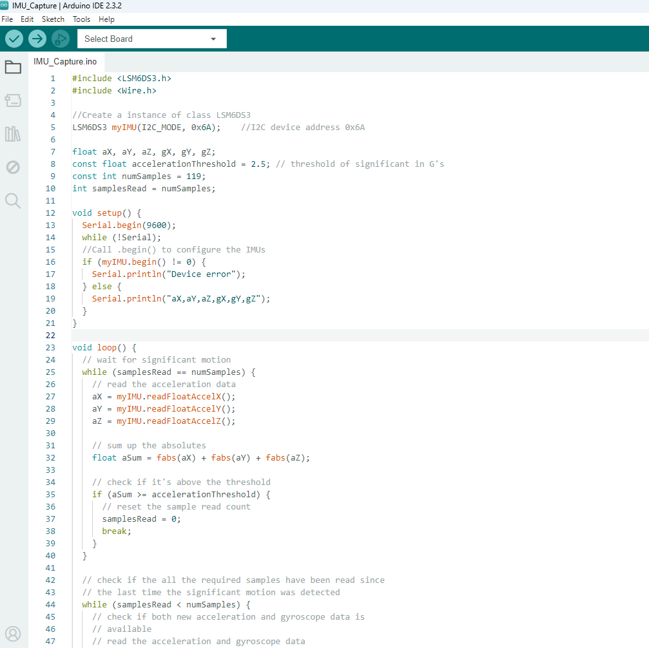
Relevant Technologies on Movement Recognition
01
Accelerometer & Gyroscope
Acc detects linear acceleration of devices, that is, the acceleration along an axis. While gyro detects the angular velocity, i.e, how fast the body is turning.
02
Ultra Low Power Embedded System
Capture, measure and report acceleration, orientation and other gravitational forces.
Bluetooth Low Energy
03
Wireless, low-power personal area network. Its goal is to connect devices over a relatively short range.

Slide 11
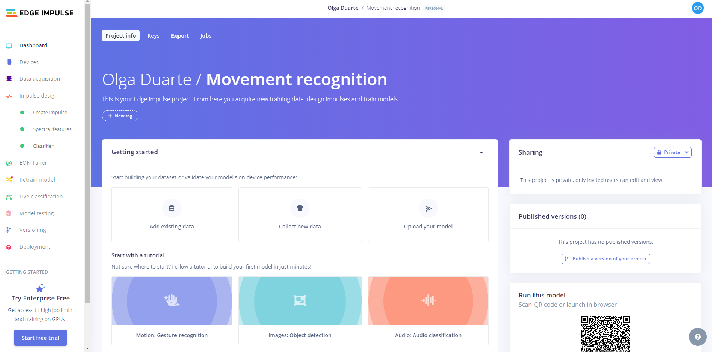
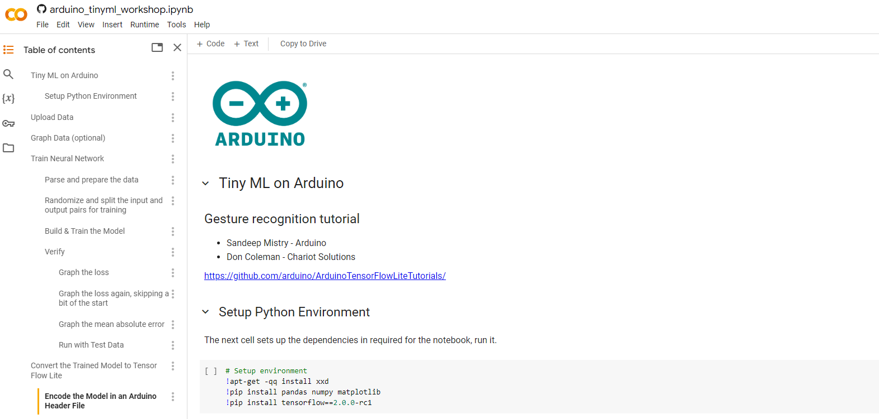
Low and No Code Platforms to train NN
Edge
Impulse
Development platform.
No cost.
Designed to run ML models on MCUs and other devices with only few kilobytes of memory.
TensorFlow Lite can be use.
No code platform.
No cost.
Integrates with small portable MCUs.
Uses TensorFlow Lite for training, optimizing, and deploying deep learning models to embedded devices.
Google
Colab

Slide 12
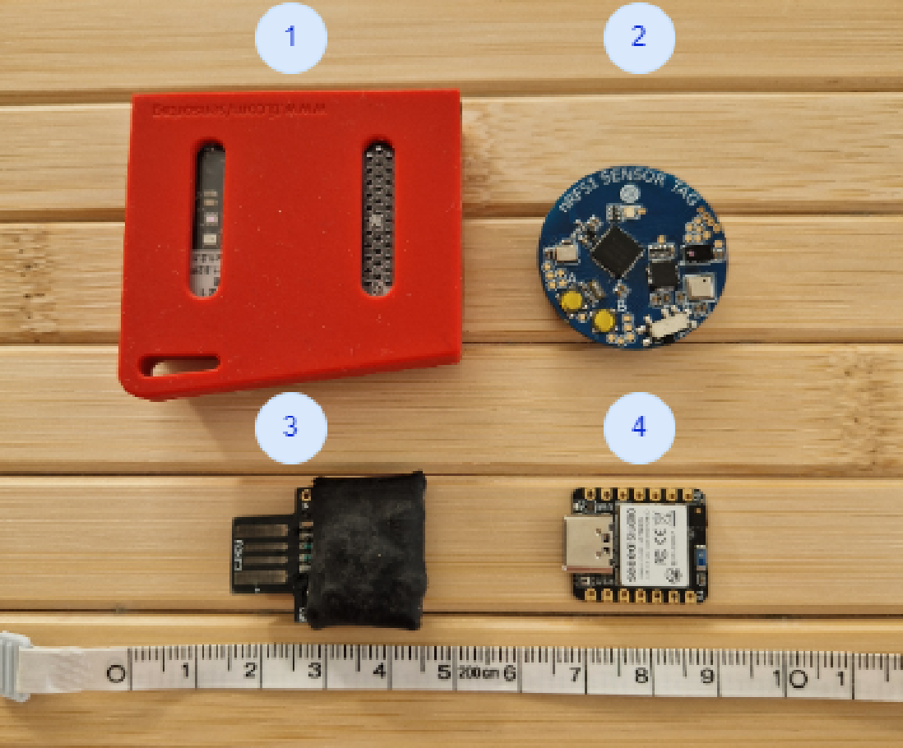
Ultra Low Power Embedded System
 | NRF51 Sensor Tag | Seeed Studio XIAO nRF52840 Sense | CJMCU Beetle | Texas Instruments TIDC-CC2650STK-SENSORTAG
Advantages | Low cost, 3 axis Accelerometer Sensor, BLE 5.0, Low Power Consumption Bluetooth. | Low cost, Low Power, BLE 5, Great documentation, not expensive, easy to start use and program, IMU with extra capabilities - like pedometer. | Low-power and extended-range Capabilities. | Advanced debugging and profiling Tools.
Disadvantages | Excluded due to the lack of examples and public documentation. | Pay more for the connectivity | Doesn’t have built-in Bluetooth capabilities. | Excluded due to the size, price and the learning curve of the software use to Develop.

Slide 13
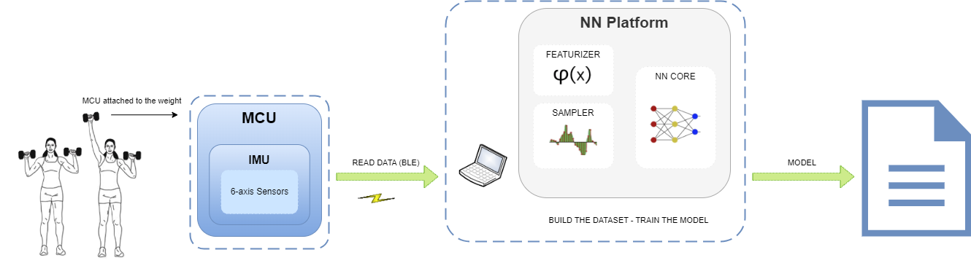
Solution Outline
01
Data collection and Model creation
Notes:
Vou recolher o dataset
Vou recolher os dados dos movimentos
Depois dessa fase, vou treinar a rede
E depois vou implementar a rede no microcontrolador
E vou refinar essa implementação, coisa que quando é feita no edge impulse ou google colab nós não temos mão para além das opções facultadas
Existe todo o interesse em exportar este trabalho para outras plataformas embebidas e conseguir compliar isto para outros sistemas, e fazer outro tipo de optimizações

Slide 14
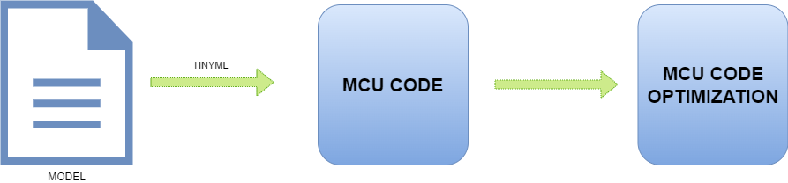
Solution Outline
02
MCU Code
Notes:
Implementar uma rede neural em C é uma escolha pragmática para aplicações em ambientes de recursos limitados, como microcontroladores e dispositivos embarcados. As vantagens de eficiência, controle de recursos, portabilidade e desempenho em tempo real fazem de C uma linguagem adequada para tais implementações, garantindo que a rede neural funcione de forma eficaz e otimizada no hardware disponível.
1. Eficiência e Desempenho
Baixo Nível de Abstração: C permite um controle mais fino sobre o hardware e a utilização dos recursos do sistema. Isso é crucial para otimizar o desempenho e a eficiência de uma rede neural, especialmente em dispositivos com recursos limitados.
Otimizações de Desempenho: C facilita a implementação de otimizações específicas de hardware, como uso eficiente de memória e processamento paralelo, que podem melhorar significativamente o desempenho da rede neural.
2. Recursos Limitados
Uso de Memória: Em dispositivos embarcados, como microcontroladores, a memória é um recurso escasso. Implementar a rede neural em C permite uma gestão mais precisa e eficiente da memória, garantindo que a aplicação não exceda os limites disponíveis.
Baixo Consumo de Energia: Algoritmos implementados em C podem ser otimizados para consumir menos energia, o que é essencial para dispositivos alimentados por bateria.
3. Portabilidade
Compatibilidade com Diversos Hardwares: C é uma linguagem amplamente suportada por diversos compiladores e arquiteturas de microcontroladores. Isso facilita a portabilidade do código entre diferentes plataformas de hardware.
Interoperabilidade: C permite fácil integração com outras bibliotecas e sistemas existentes, o que é útil para construir aplicações complexas onde a rede neural é apenas uma parte do sistema.

Slide 15
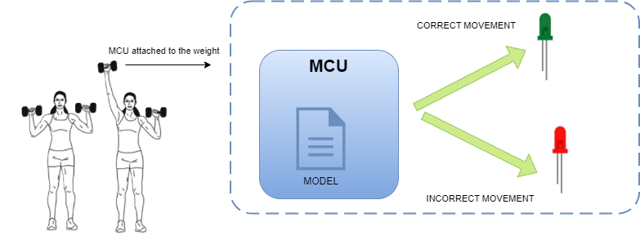
Solution Outline
03
Solution Outline

Slide 16
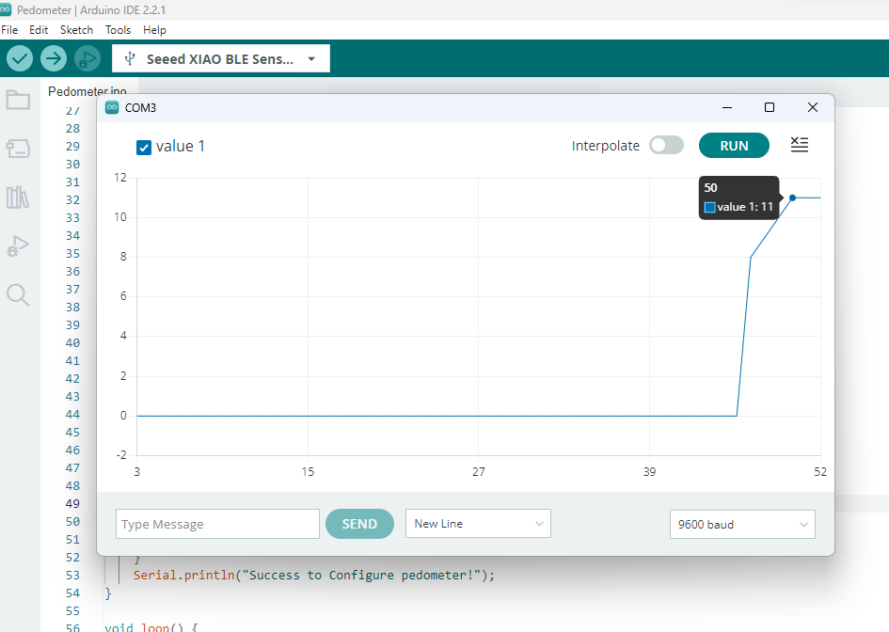
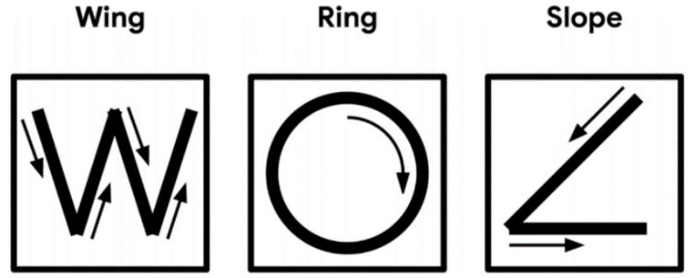
Preliminary Results​
01
Pedometer experience
Step counter, collecting the data from the sensor.
Confirm that the onboard sensors (such as the accelerometer and gyroscope) were working properly.
Check that the sensors provide accurate and reliable motion data that can be used for step detection.
02
Magic Wand – Tiny ML
The goal was to analyze the 3-axis (X, Y, and Z) returns in different movements.
Validate the values returned and classify the gestures based on the accelerometer data.

Slide 17
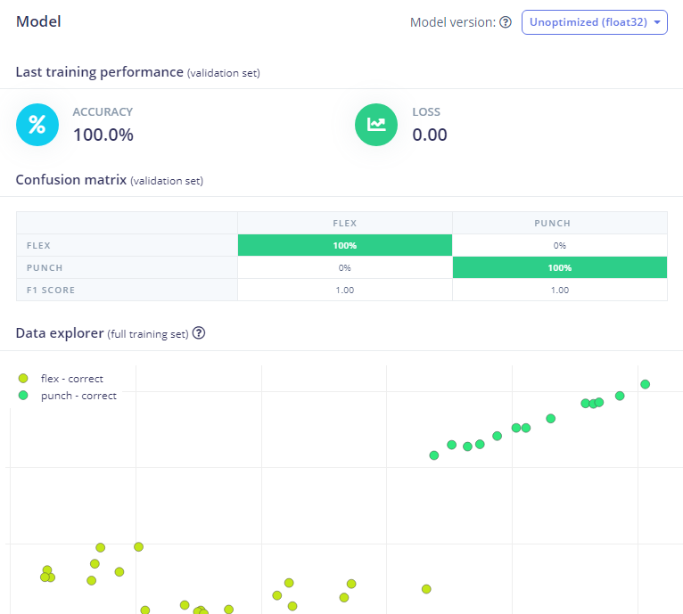
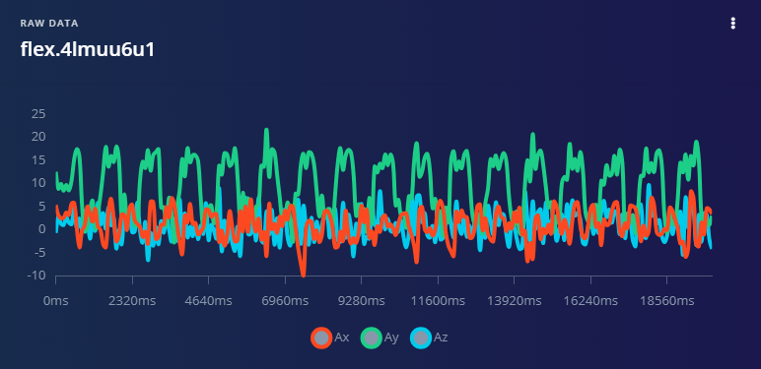
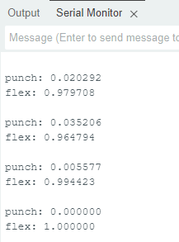
Preliminary Results​
03
Evaluation of TensorFlow Lite using the Edge Impulse Platform
The data was capture using the IMU sensor to collect the accelerometer and gyroscope values, while performing a movement like flex or punch for 20 seconds each.
The NN was trained using Edge impulse and the result model was uploaded to the MCU using TensorFlow Lite (in Arduino).

Slide 18
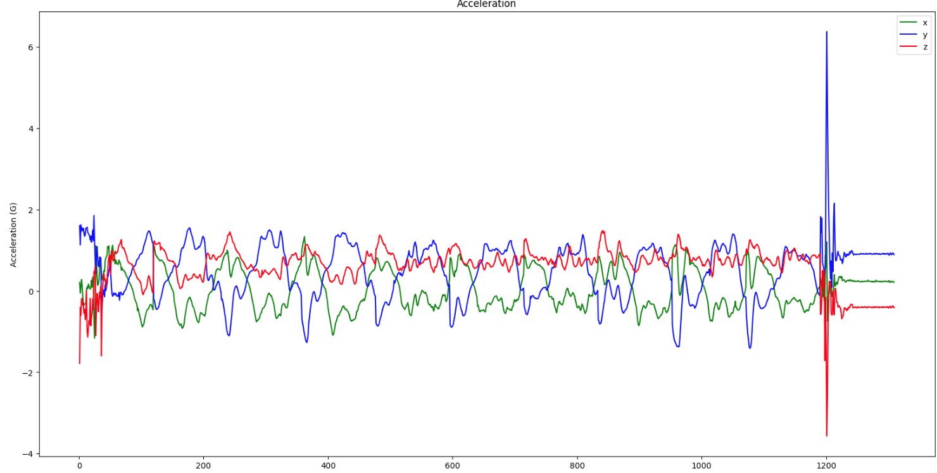
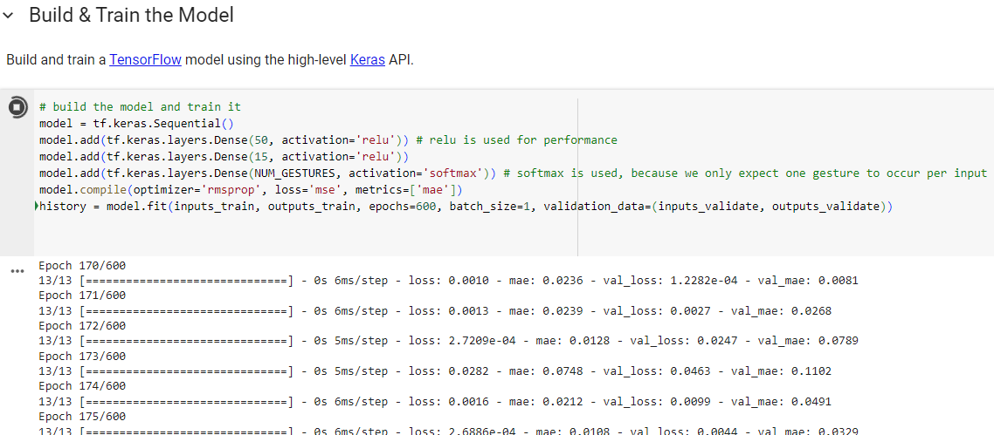
Preliminary Results​
04
Evaluation of TensorFlow Lite Using the Google Colab Platform
The data was capture using the IMU sensor to collect the accelerometer and gyroscope values, while performing a movement like flex or punch for 10 times each.
The NN was trained using a notebook (python code) in Google Colab and the model was included in the MCU using TensorFlow Lite.
The downloaded TensorFlow Lite model file (model.h) was used to recognize the punch and flex actions from Seeed Studio XIAO nRF52840 Sense.
Notes:
Enviar o datasheet <---
Comunicar sintese do que fiz
Take points / "sell" message
Trabalho de pesquisa, e os ensaios

Slide 19
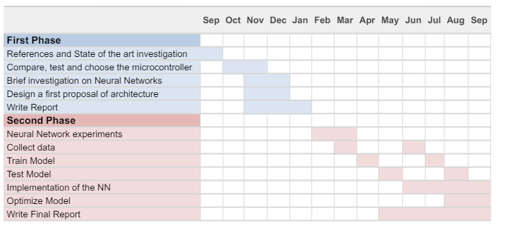
Work Plan
Here
Notes:
Implementar a rede neuronal em C
Plano de trabalho:
Junho - recolha de dados e definição da rede neural e começar a implementar
cada pessoa fazer 10 repetições bem e mal (5 pessoas)

Slide 20
Conclusions
Concluding that I can use this platform for step recognition, I have already carried out preliminary tests to validate that the solution works for the intended objectives.
I am studying neural networks and I have some source code to use as a reference to guide my own implementation of an open source neural network.
Next Steps:
Program a NN to run on the selected MCU
Optimize the construction of the Model due to limitations (such as limited storage and memory)
Try to improve battery usage
Notes:
implementar a rede é fazer o código no microcontrolador que vai fazer a rede funcionar que leva os valores do modelo
Modelo é só um conjunto de valores que vão entrar dentro do algoritmo de rede neuronal que irei implementar em C
Conclui-se que consigo usar esta plataforma para reconhecimento de passos, já fiz ensaios preliminares para validar que a solução funciona para os objectivos pretendidos.
Estive a estudar redes neuronais e tenho como referência código fonte para guiar a minha própria implementação para ter uma rede neuronal implementada aberta

Slide 21
THANK YOU!
Notes:
Colocar referências

Slide 22
Ang´, T. A., & Gonç, A. (2022). Convolutional Neural Network for Hand Gesture Identification on FPGAs Electrical and Computer Engineering.
Banbury, C., Zhou, C., Fedorov, I., Navarro, R. M., Thakker, U., Gope, D., Reddi, V. J., Mattina, M., & Whatmough, P. N. (2021). BAMBURY_micronets-neural-network-architectures-for-deploying-tinyml-applications-on-commodity-microcontrollers-Paper_2021.
Brock, H., Ohgi, Y., & Lee, J. (2017). Learning to Judge Like a Human: Convolutional Networks for Classification of Ski Jumping Errors.
Buckley, C., O’ Reilly, M. A., Farrel, A. V., Clark, L., & Longo, V. (2017). Binary Classification of Running Fatigue using a Single Inertial Measurement Unit.
Bulling, A., Blanke, U., & Schiele, B. (2014). A Tutorial on Human Activity Recognition Using Body-Worn Inertial Sensors.
Chowdhary, M., & Saha, S. S. (2023). On-Sensor Online Learning and Classification Under 8 KB Memory.
Cust Emily E, Sweeting Alice J, Ball Kevin, & Robertson Sam. (2018). Machine and deep learning for sport-specific movement recognition: a systematic review of model development and performance. https://www.tandfonline.com/doi/full/10.1080/02640414.2018.1521769
Diab, M. S., & Rodriguez-Villegas, E. (2022). Embedded Machine Learning Using Microcontrollers in Wearable and Ambulatory Systems for Health and Care Applications: A Review.
Groh, B. H., Kautz, T., & Schuldhaus, D. (2015). IMU-based Trick Classification in Skateboarding.
Gupta, S. (2022). A TinyML Approach to Human Activity Recognition.
Jarning, J. M., Mok, K.-M., Hansen, B. H., & Bahr, R. (2015). Application of a tri-axial accelerometer to estimate jump frequency in volleyball.
Jensen, U., Schmidt, M., Hennig, M., Dassler, F. A., Jaitner, T., & Eskofier, B. M. (2015). An IMU-based Mobile System for Golf Putt Analysis.
Kautz, T., Groh, B. H., Hannink, J., Jensen, U., Strubberg, H., & Eskoﬁer, B. M. (2017). Activity recognition in beach volleyball using a Deep Convolutional Neural Network.
Lanraoui, N., & Touati, C. (2023). Tiny ML for Gesture Recognition.
Lattanzi, E., Donati, M., & Freschi, V. (2022). Exploring Artificial Neural Networks Efficiency in Tiny Wearable Devices for Human Activity Recognition. https://www.mdpi.com/1424-8220/22/7/2637
Munguia Tapia, E., Intille, S. S., Haskell, W., Larson, K., Wright, J., King, A., & Friedman, R. (2007). Real-Time Recognition of Physical Activities and Their Intensities Using Wireless Accelerometers and a Heart Rate Monitor .
Rindal, O. M. H., Seeberg, T. M., Tjønnås, J., Haugnes, P., & Sandbakk, Ø. (2017). Automatic Classification of Sub-Techniques in Classical Cross-Country Skiing Using a Machine Learning Algorithm on Micro-Sensor Data.
Rueda, F. M., Grzeszick, R., Fink, G. A., Feldhorst, S., & Hompel, ten M. (2018). Convolutional Neural Networks for Human Activity Recognition Using Body-Worn Sensors.
Sanchez‐Iborra, R., & Skarmeta, A. (2021). Who is wearing me? TinyDL‐based user recognition in constrained personal devices.
Shalev-Shwartz, S., & Ben-David, S. (2014). Understanding Machine Learning: From Theory to Algorithms. Published 2014 by Cambridge University Press.
Wang, Z., Wu, Y., Jia, Z., Shi, Y., & Hu, J. (2021). Lightweight Run-Time Working Memory Compression for Deployment of Deep Neural Networks on Resource-Constrained.
Warden Peter, & Situnayake Daniel. (2019). TinyML - Machine Learning with TensorFlow Lite on Arduino and Ultra-Low-Power Microcontrollers. https://books.google.pt/books?hl=en&lr=&id=tn3EDwAAQBAJ&oi=fnd&pg=PP1&ots=jqllbr-7A4&sig=GAqcAA99f2EPyvOjOaddMu8gzss&redir_esc=y#v=onepage&q&f=false
Xia, S., de Godoy, D., Islam, B., Islam, M. T., Nirjon, S., Kinget, P. R., & Jiang, X. (2019). Improving Pedestrian Safety in Cities using Intelligent Wearable Systems.
Yauri, R., & Espino, R. (2022). Edge device for movement pattern classification using neural network algorithms.

